Slide 1
木兰女童和妇女教育基金会网站

Slide 2
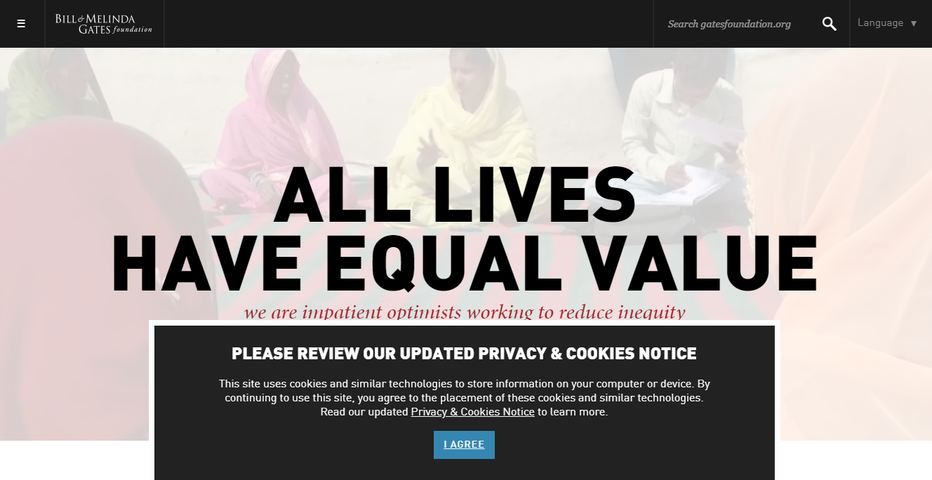
FUNDATION WEBSITE INSPIRATIONs
https://www.gatesfoundation.org/

Slide 3
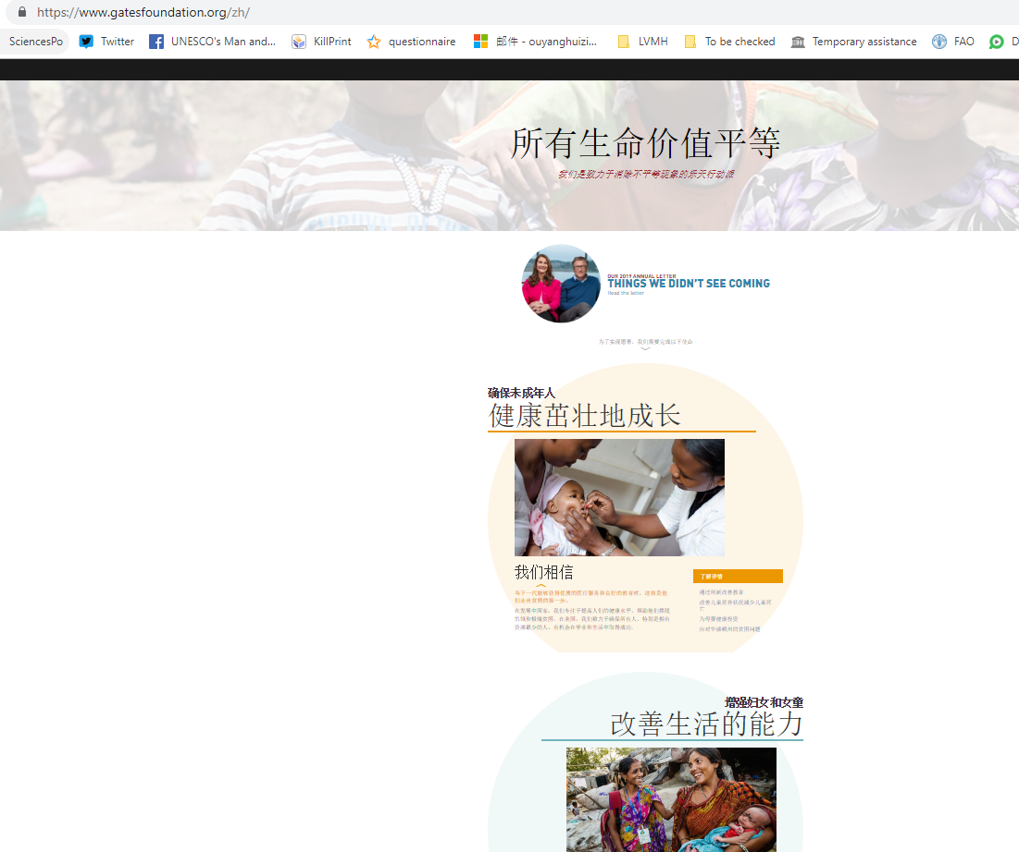

Slide 4
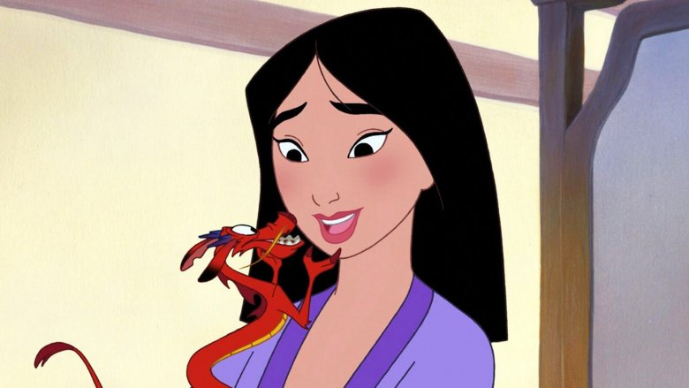

Slide 5



AI FOR GIRL & WOMAN
AI FOR GIRL & WOMAN

Slide 6


Slide 7


Slide 8


Slide 9


Slide 10
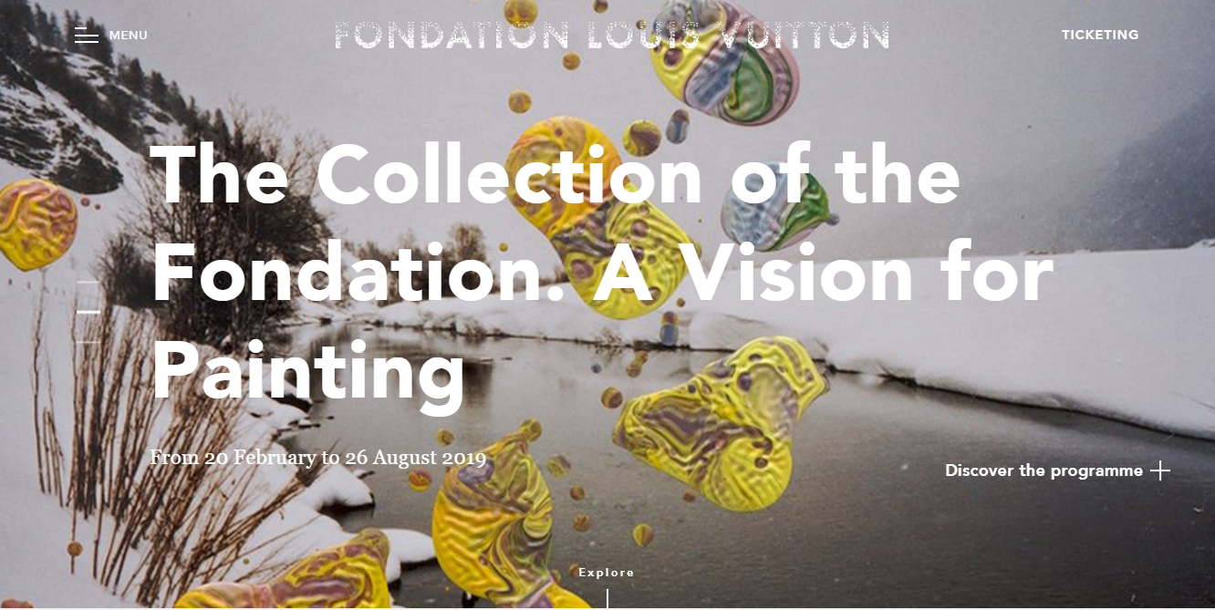
FUNDATION WEBSITE INSPIRATIONs
https://www.fondationlouisvuitton.fr/en.html

Slide 11
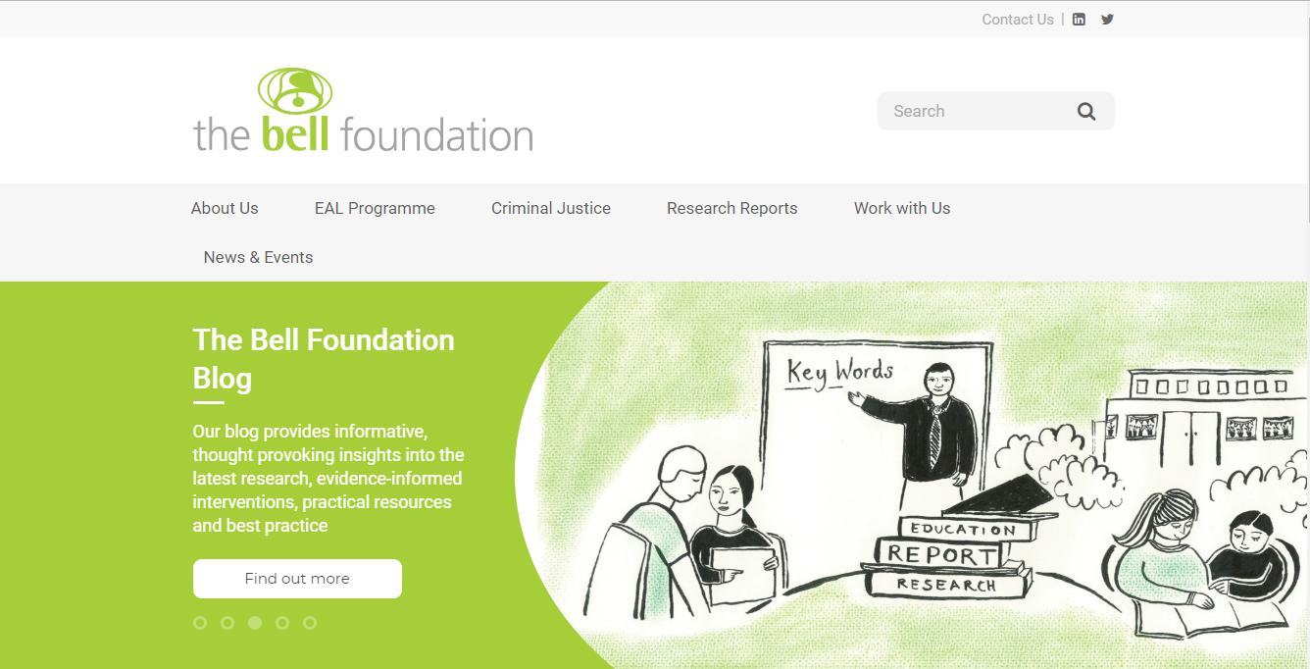
FUNDATION WEBSITE INSPIRATIONs
https://www.bell-foundation.org.uk/

Slide 12
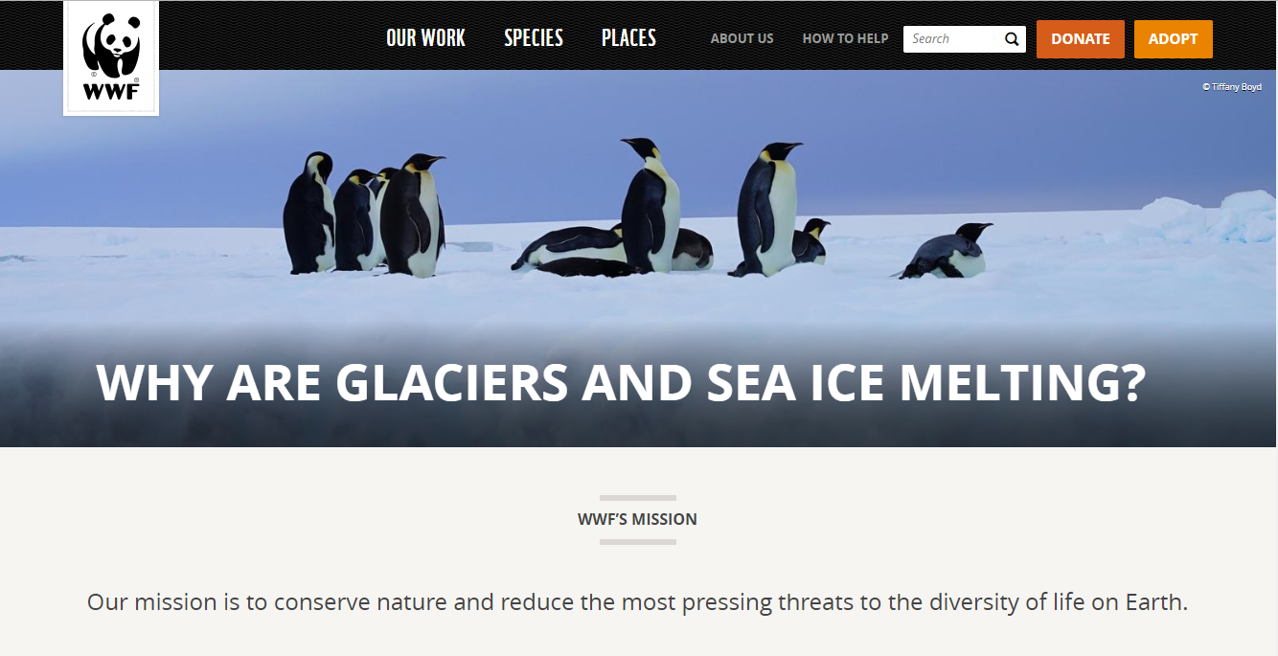
FUNDATION WEBSITE INSPIRATIONs
https://www.worldwildlife.org/

Slide 13

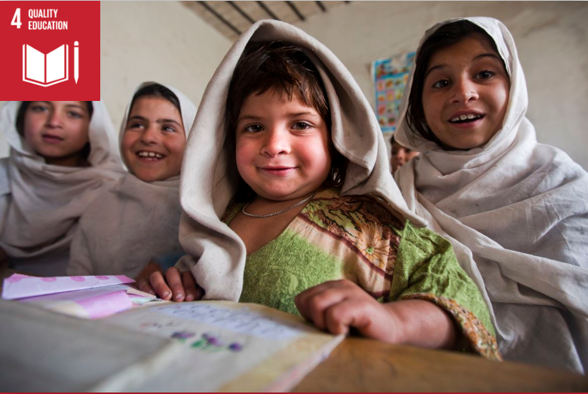
Goal 4: Quality education
Since 2000, there has been enormous progress in achieving the target of universal primary education. The total enrolment rate in developing regions reached 91 percent in 2015, and the worldwide number of children out of school has dropped by almost half. There has also been a dramatic increase in literacy rates, and many more girls are in school than ever before.
These are all remarkable successes.
Progress has also been tough in some developing regions due to high levels of poverty, armed conflicts and other emergencies. In Western Asia and North Africa, ongoing armed conflict has seen an increase in the number of children out of school. This is a worrying trend.
While Sub-Saharan Africa made the greatest progress in primary school enrolment among all
developing regions – from 52 percent in 1990, up to 78 percent in 2012 – large disparities still remain. Children from the poorest households are up to four times more likely to be out of school than those of the richest households.
Disparities between rural and urban areas also remain high.
Achieving inclusive and quality education for all reaffirms the belief that education is one of the most powerful and proven vehicles for sustainable development. This goal ensures that all girls and boys complete free primary and secondary schooling by 2030. It also aims to provide equal access to affordable vocational training, to eliminate gender and wealth disparities, and achieve universal access to a quality higher education.

Slide 14

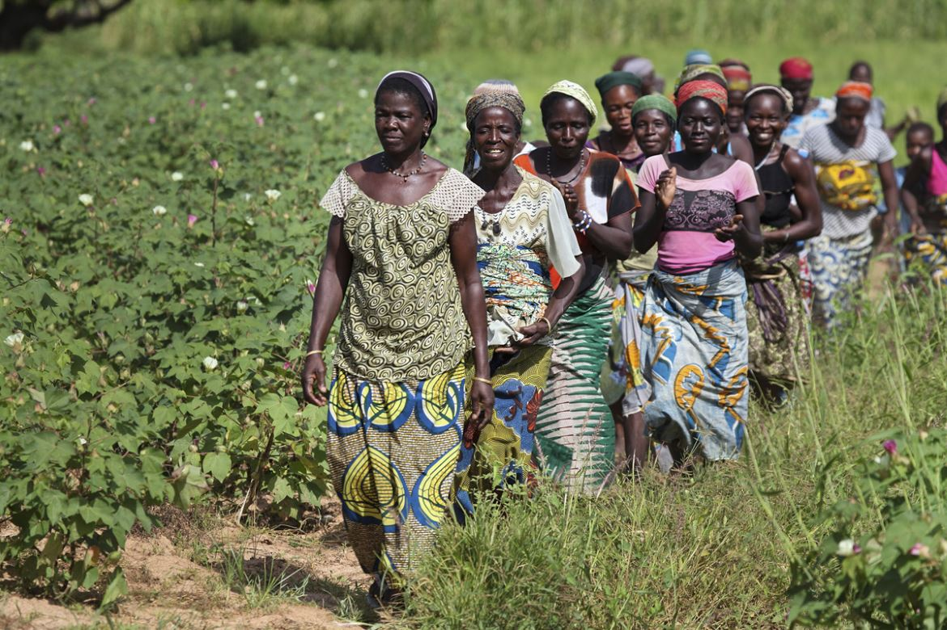
Goal 5: Gender equality
Ending all discrimination against women and girls is not only a basic human right, it’s crucial for sustainable future; it’s proven that empowering women and girls helps economic growth and development.
UNDP has made gender equality central to its work and we’ve seen remarkable progress in the past 20 years. There are more girls in school now compared to 15 years ago, and most regions have reached gender parity in primary education.
But although there are more women than ever in the labour market, there are still large inequalities in some regions, with women systematically denied the same work rights as men. Sexual violence and exploitation, the unequal division of unpaid care and domestic work, and discrimination in public office all remain huge barriers. Climate change and disasters continue to have a disproportionate effect on women and children, as do conflict and migration.
It is vital to give women equal rights land and property, sexual and reproductive health, and to technology and the internet. Today there are more women in public office than ever before, but encouraging more women leaders will help achieve greater gender equality.

Slide 15

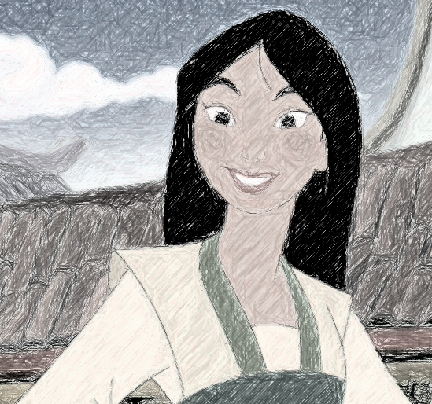
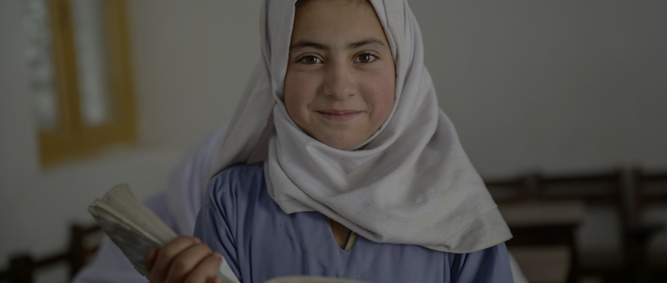
合作伙伴
新闻中心
我们的活动
EN
关于我们
联系我们
木兰女童和妇女教育基金会
我们

Slide 16
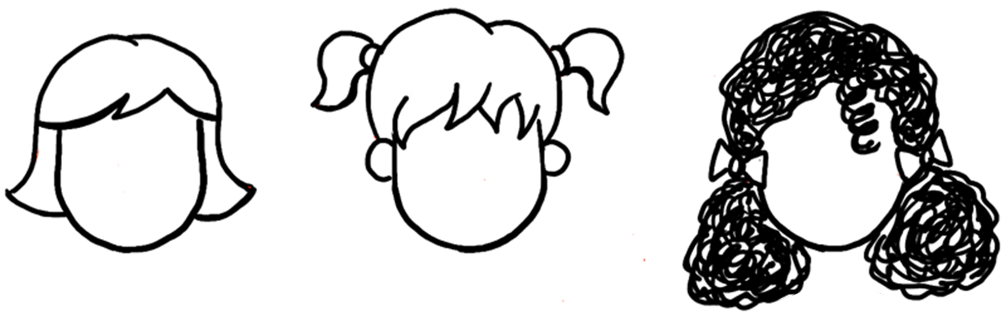
合作伙伴
新闻中心
我们的活动
EN
关于我们
联系我们
我们的愿景
开展全球范围的女童和妇女教育公益慈善活动，通过为女性提供人工智能及编程教育
通过网络教育
及在线工作
消除地域差异
消除性别歧视
实现性别平等
促进女性就业
提高生活质量

Slide 17
NEWS CENTER
OUR PARTNERS
OUR PROJECTS
EN
ABOUT US
CONTACT US
OUR VISION
Empower girl and woman with artificiel intelligence knowledge and coding skill
Through charity activities dedicated to education for girl and woman at a global level
EMILINATE
UNEVEN
DISTRIBUTION OF
RESOURCES
AMONG REGIONS
BY DEVELOPING
DIGITAL SOLUTIONS
FOR EDUCATION
ELIMINATE
GENDER
DISCRIMINATION
ACHIEVE
GENDER
EQUALITY
PROMOTE FEMALE
EMPLOYMENT
IMPORVE QUALITY
OF LIFE

Slide 18
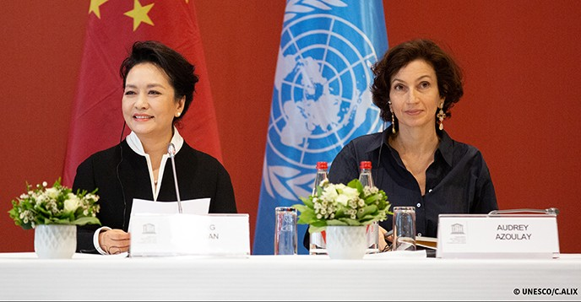
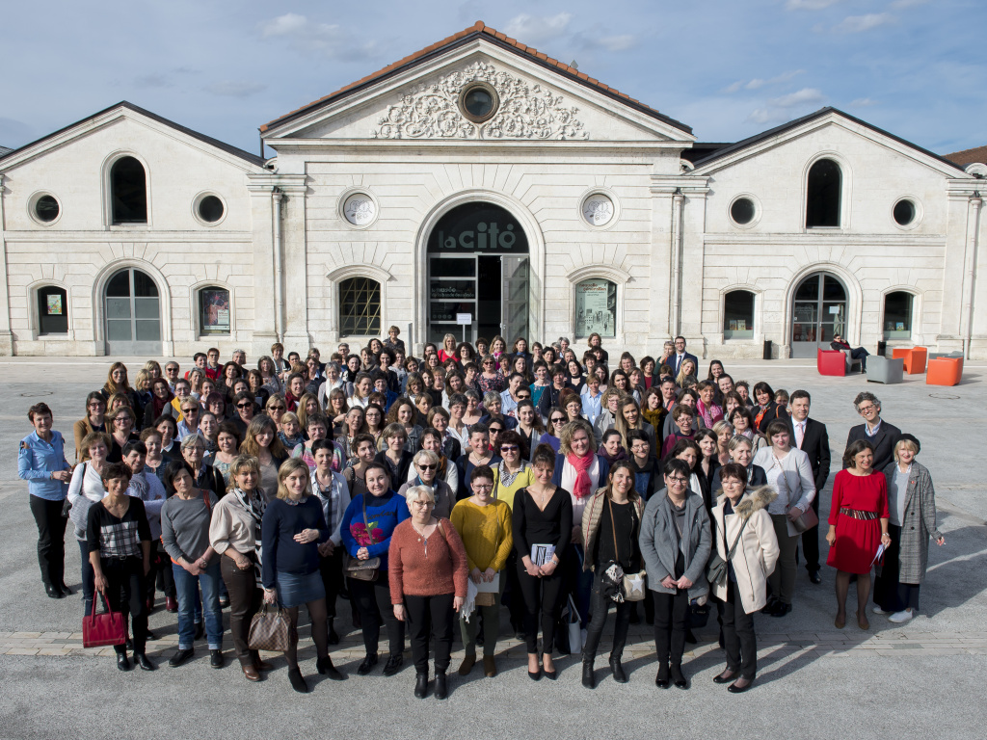
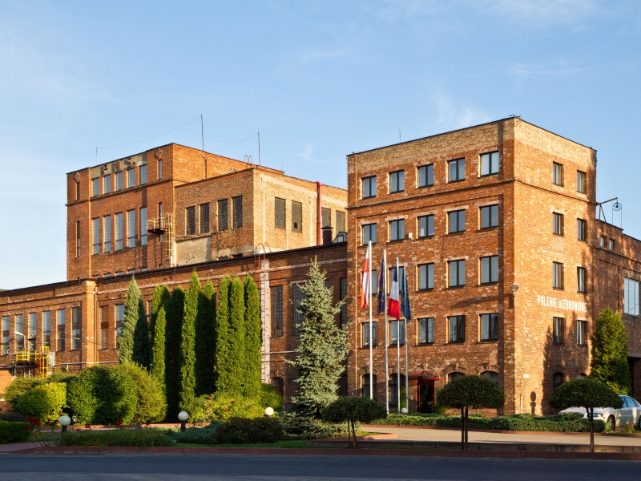
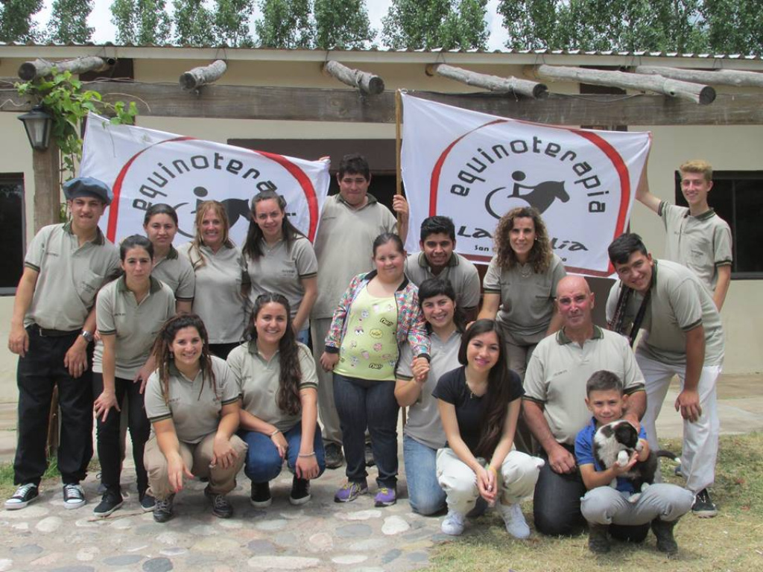
合作伙伴
新闻中心
我们的活动
EN
关于我们
联系我们
NEWS CENTER
Visit of the First Lady of the People's Republic of China to UNESCO on the occasion of the UNESCO Prize for Girls' and Women's Education
26 March 2019
Sdfijqofij fqsdf qfsdfsdjflksjflk sjdfljslkdjfldskjflkdsjfkl sjfzoirzekz zefezjrezjroi ezs fs)azeoij d isf
Sdf sdfs fsifjezoize fezknf lezjflkezjflkezjlkjezljezlf
26 September 2018
Sdfijqofij fqsdf qfsdfsdjflksjflk sjdfljslkdjfldskjflkdsjfkl sjfzoirzekz zefezjrezjroi ezs fs)azeoij d isf
Sdf sdfs fsifjezoize fezknf lezjflkezjflkezjlkjezljezlf
26 September 2018
Sdfijqofij fqsdf qfsdfsdjflksjflk sjdfljslkdjfldskjflkdsjfkl sjfzoirzekz zefezjrezjroi ezs fs)azeoij d isf
Sdf sdfs fsifjezoize fezknf lezjflkezjflkezjlkjezljezlf
26 September 2018

Slide 19
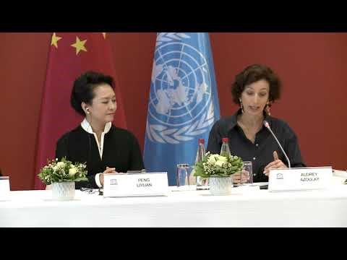
合作伙伴
新闻中心
我们的活动
EN
关于我们
联系我们
Visit of the First Lady of the People's Republic of China to UNESCO on the occasion of the UNESCO Prize for Girls' and Women's Education
26 September 2018
This visit by Professor Peng Liyuan, First Lady of the People’s Republic of China, to an event on girls’ and women's education at UNESCO Headquarters is a further expression of her support for the Organization’s action in favour of this priority cause. Winners of the four editions of the UNESCO Prize for Girls’ and Women’s Education gathered at the event and bore testimony of the significant local impact of the Prize on the empowerment of girls and women through education.
Speaking at the event, Ms Azoulay declared: “UNESCO greatly appreciates Peng Liyuan’s personal commitment to the cause of girls’ and women’s education, as well as our long-standing partnership with China to ensure that access to quality education for girls and boys becomes a reality. This is a priority issue for our Organization, a matter of dignity but also an extraordinary accelerator for the development of our societies.”
“China is a strategic partner of UNESCO, particularly committed to multilateralism,” the Director-General also said. “It supports the core of UNESCO’s missions, including the education of girls and women on the one hand, and Africa through major education projects on the other.”
The visit of President Xi Jinping and the First Lady to UNESCO Headquarters in March 2014 marked a milestone in China’s relations with UNESCO. During Audrey Azoulay’s visit to China last July, President Xi highlighted his country’s commitment to a new era of cooperation with the Organization.
https://en.unesco.org/news/visit-first-lady-peoples-republic-china-unesco-occasion-unesco-prize-girls-and-womens-education
Audrey Azoulay, Director-General of UNESCO, held talks with Professor Peng Liyuan, UNESCO Special Envoy for the Advancement of Girls’ and Women’s Education at the Organization’s Headquarters on 26 March.
新闻中心

Slide 20

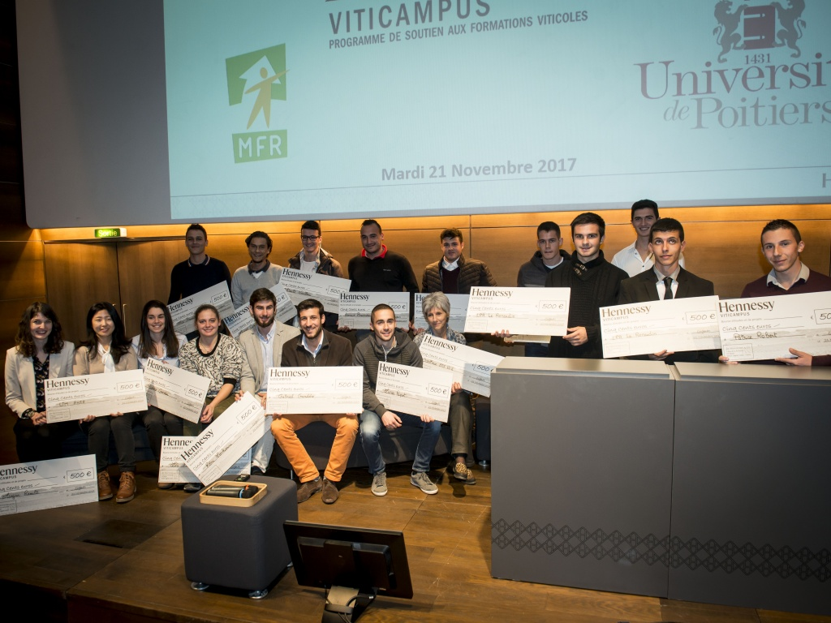
合作伙伴
新闻中心
我们的活动
EN
关于我们
联系我们
我们的活动
https://en.unesco.org/news/visit-first-lady-peoples-republic-china-unesco-occasion-unesco-prize-girls-and-womens-education
Sljfdlks jfdsfsdf dsf sdfsfk jlksjflsdj lkffsldjfslk jdskjf dssjfjdsoif sdf sdjofd jsdfs ojfoids jfsf sdjfoi jsosdjf dsfj ojsdf sd
Sljfdlks jfdsfsdf dsf sdfsfk jlksjflsdj lkffsldjfslk jdskjf dssjfjdsoif sdf sdjofd jsdfs ojfoids jfsf sdjfoi jsosdjf dsfj ojsdf sd

Slide 21

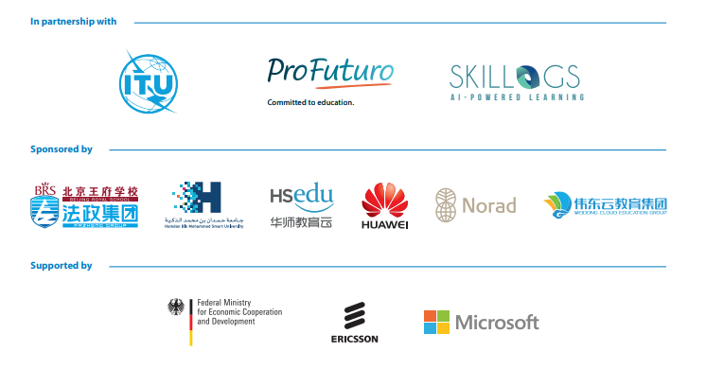
合作伙伴
新闻中心
我们的活动
EN
关于我们
联系我们
Artificial Intelligence for Sustainable Development
Sdfijqofij fqsdf qfsdfsdjflksjflk sjdfljslkdjfldskjflkdsjfkl sjfzoirzekz zefezjrezjroi ezs fs)azeoij d isf
Sdf sdfs fsifjezoize fezknf lezjflkezjflkezjlkjezljezlf
fezknf lezjflkezjflkezjlkjezljezlf
qfezjflksdfsdjflksjflk ezjflksjdfljslkezjflkezjflkdjfldskjflkdsjfkl sjfzoirzekz zefezjrezjroi ezs fs)azeoij d ezjflkisf
Sdf sdfs fsifjezoize fezknf lezjflkezjflkezjlkjezljezlf
fezknf lezjflkezjflkezjlkjezljezlf
26 September 2018
点击进入联合国教科文组织首页查看
https://en.unesco.org/mlw

Slide 22




合作伙伴
新闻中心
我们的活动
EN
关于我们
联系我们
合作伙伴
查看主页
查看主页
查看主页
查看主页

Slide 23
合作伙伴
新闻中心
我们的活动
EN
关于我们
联系我们
Artificial Intelligence for Sustainable Development
Sdfijqofij fqsdf qfsdfsdjflksjflk sjdfljslkdjfldskjflkdsjfkl sjfzoirzekz zefezjrezjroi ezs fs)azeoij d isf
Sdf sdfs fsifjezoize fezknf lezjflkezjflkezjlkjezljezlf
fezknf lezjflkezjflkezjlkjezljezlf
qfezjflksdfsdjflksjflk ezjflksjdfljslkezjflkezjflkdjfldskjflkdsjfkl sjfzoirzekz zefezjrezjroi ezs fs)azeoij d ezjflkisf
Sdf sdfs fsifjezoize fezknf lezjflkezjflkezjlkjezljezlf
fezknf lezjflkezjflkezjlkjezljezlf

Slide 24


合作伙伴
新闻中心
我们的活动
EN
关于我们
联系我们
联系我们
在社交媒体上关注我们
联系我们负责人
上海
香港
巴黎
GONG. Hao
(0086) 13788596845
H.gong@gmail.com
Max. JIANG
(0045) 138596845
H.gong@gmail.com
CHEN. Hui
(0033) 13788596845
H.gong@gmail.com

Slide 25
ENGLISH

Slide 26
合作伙伴
新闻中心
我们的活动
EN
关于我们
联系我们
CONTACT US
FOLLOW OUR DAILY ACTIVITY ON SOCIAL MEDIA
CONTACT OUR OFFICIES
SHANGHAI
HONGKONG
PARIS
GONG. Hao
(0086) 13788596845
H.gong@gmail.com
Max. JIANG
(0066) 138596845
H.gong@gmail.com
CHEN. Hui
(0033) 13788596845
H.gong@gmail.com

